Slide 1

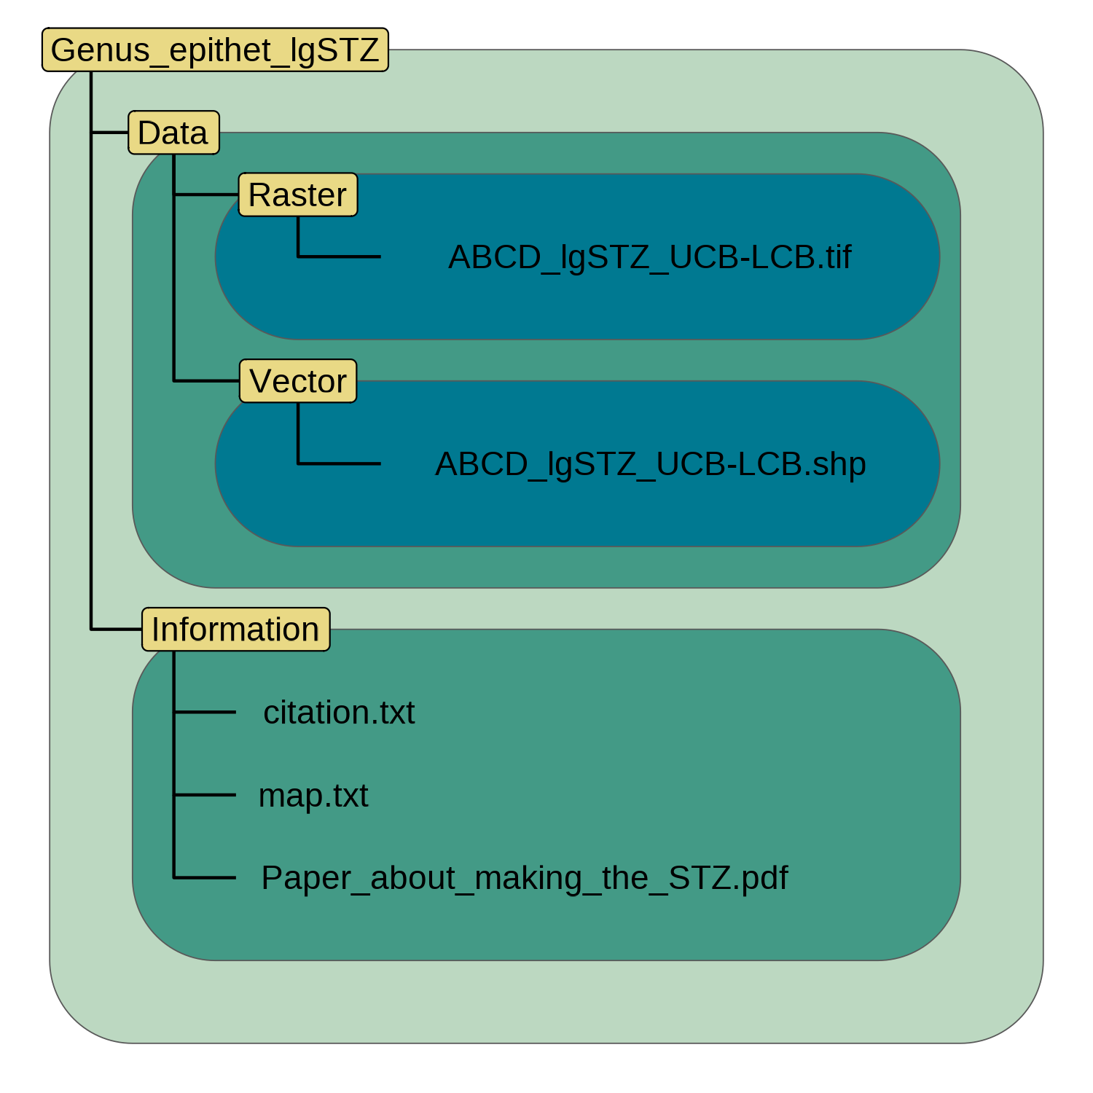
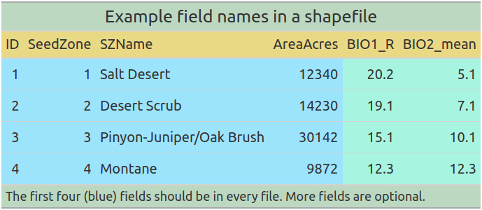
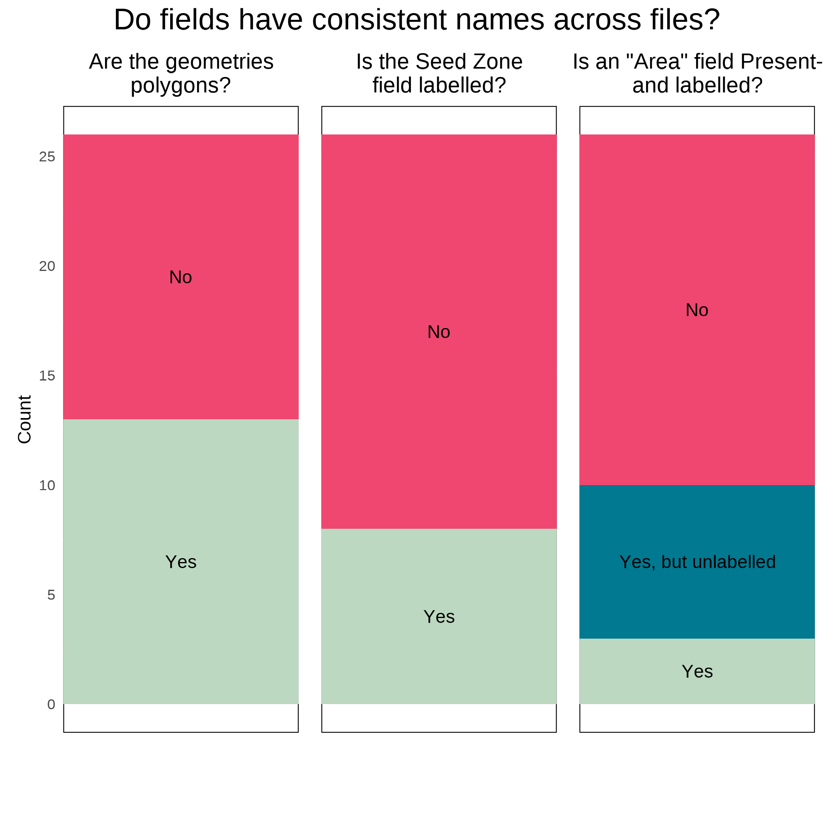
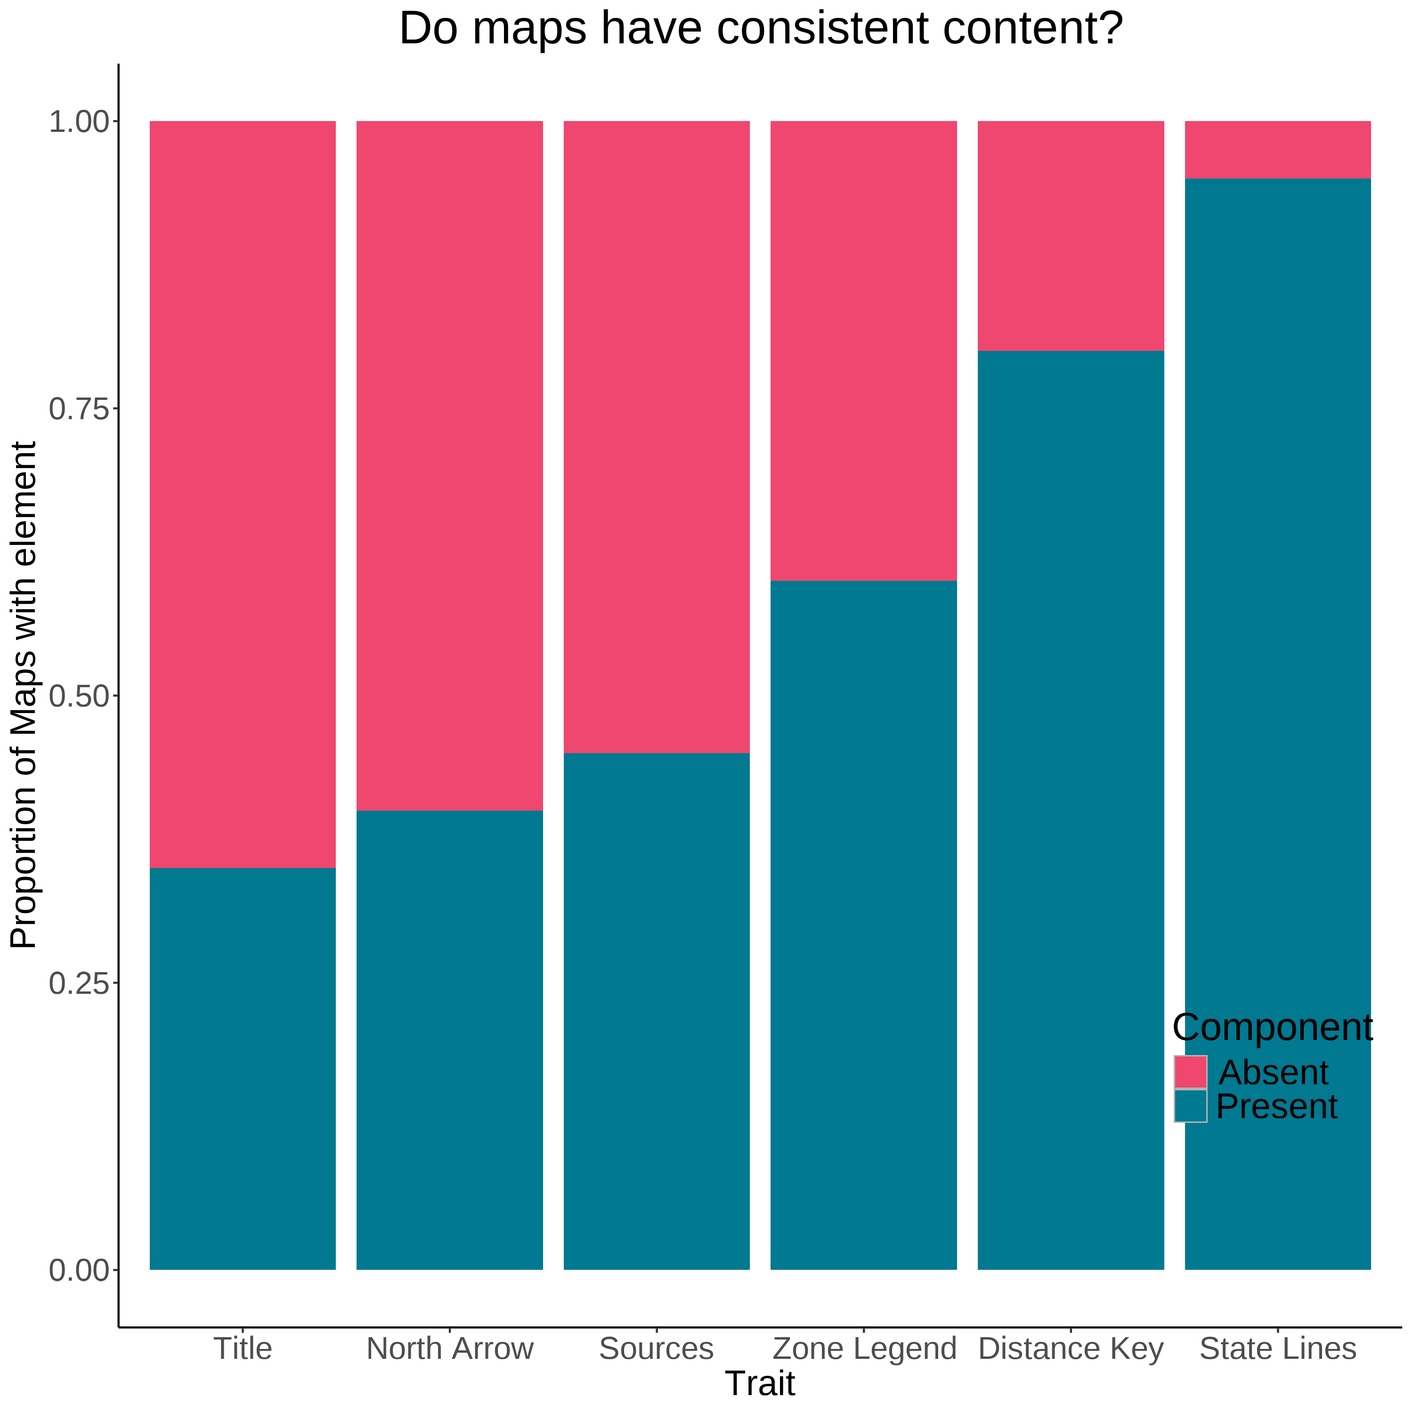

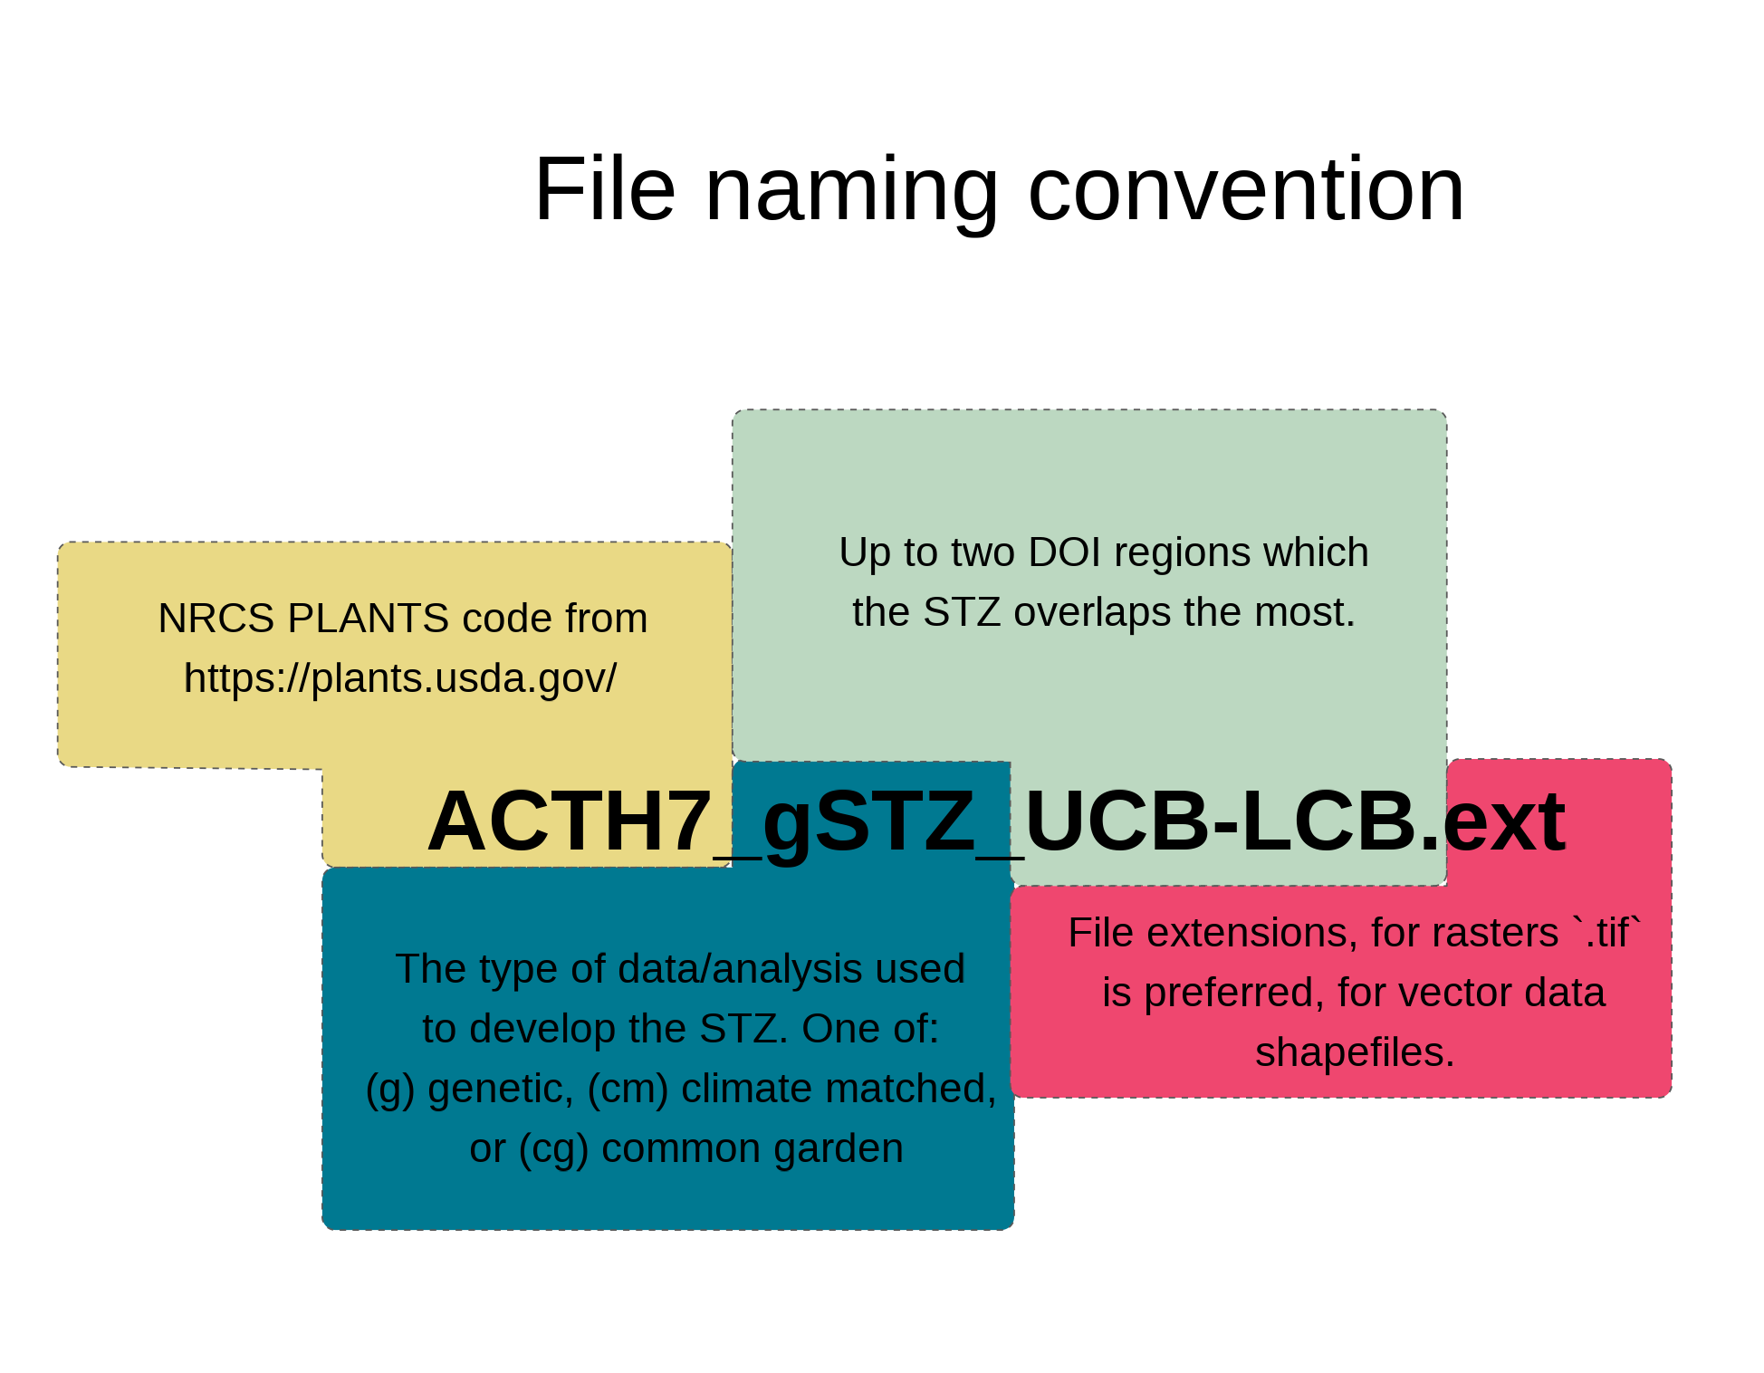
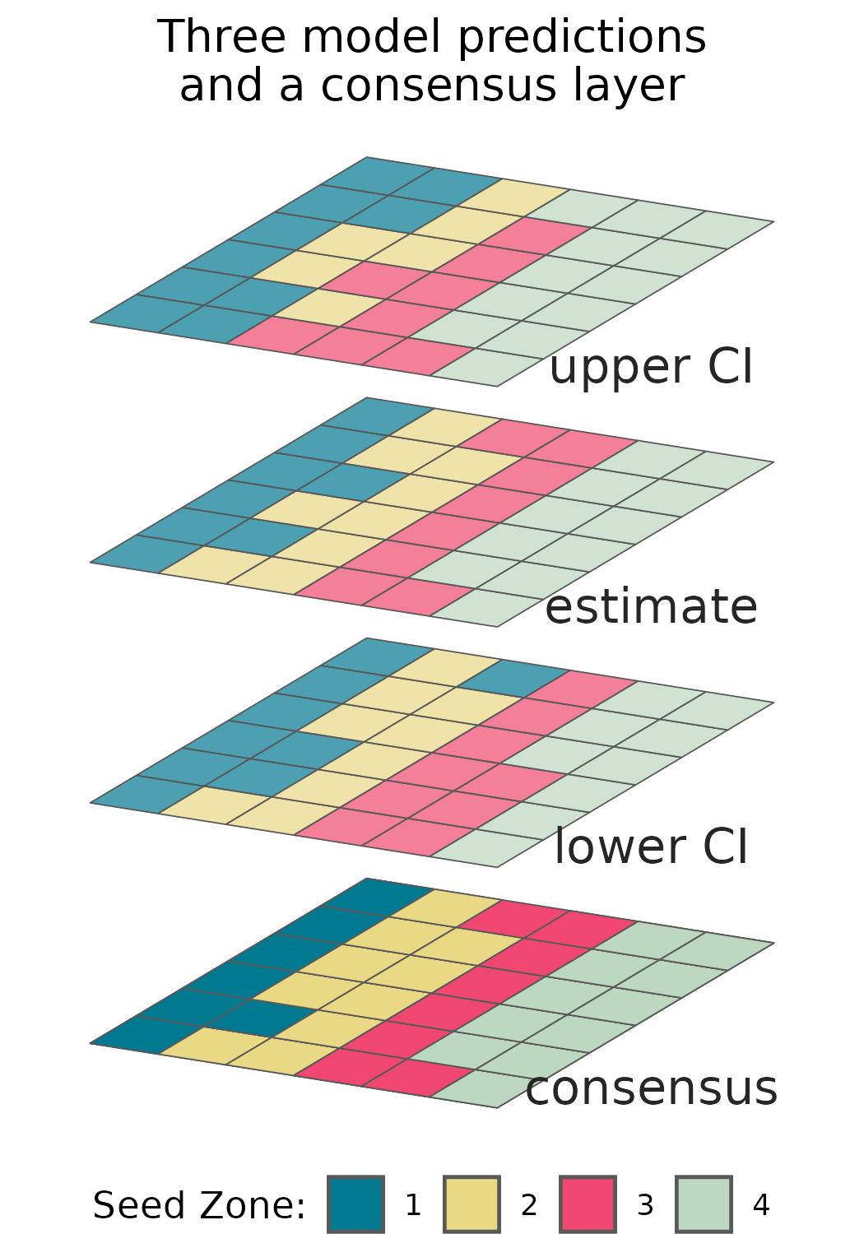
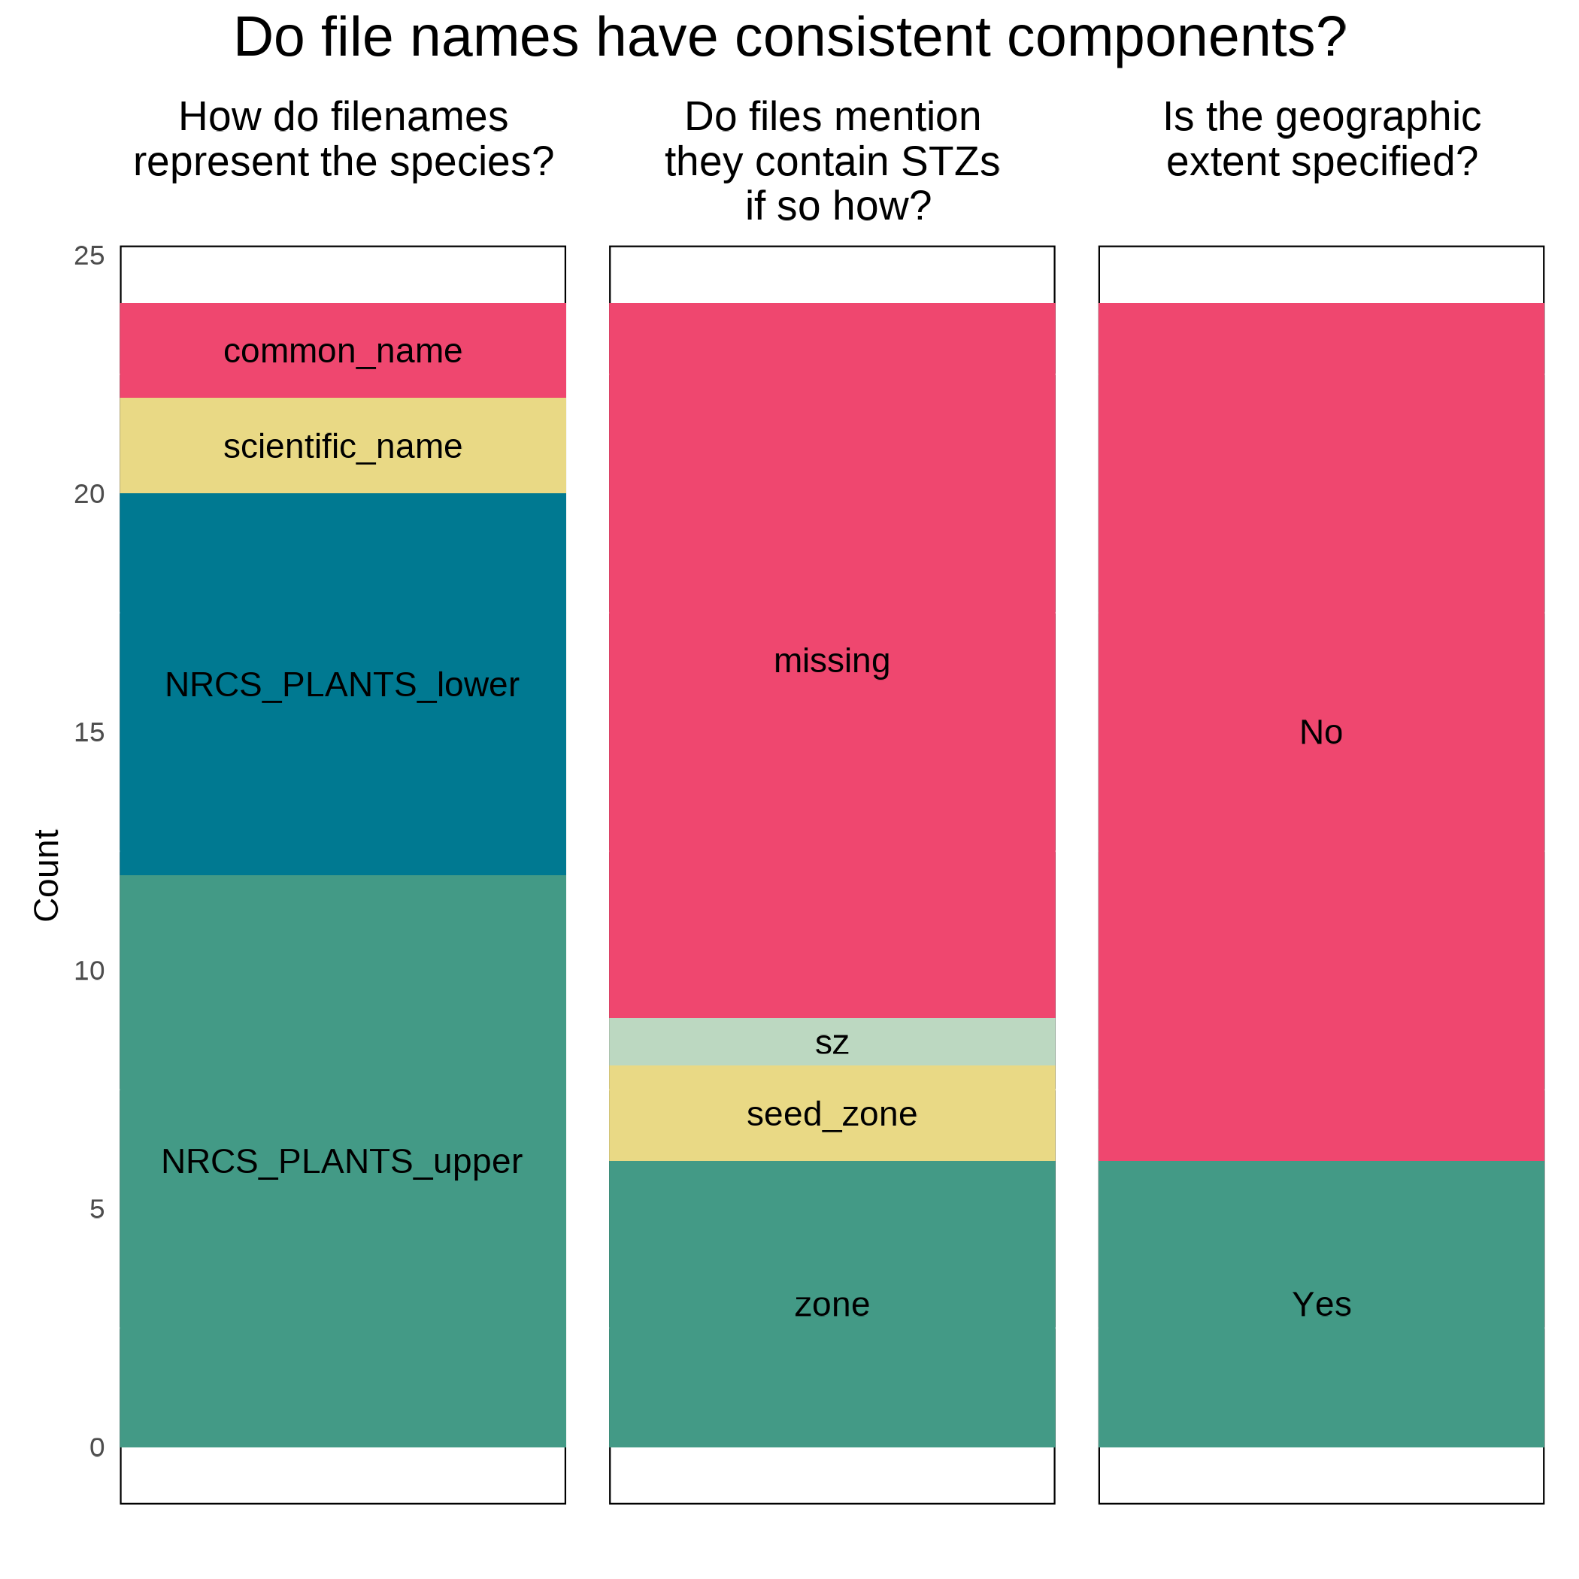
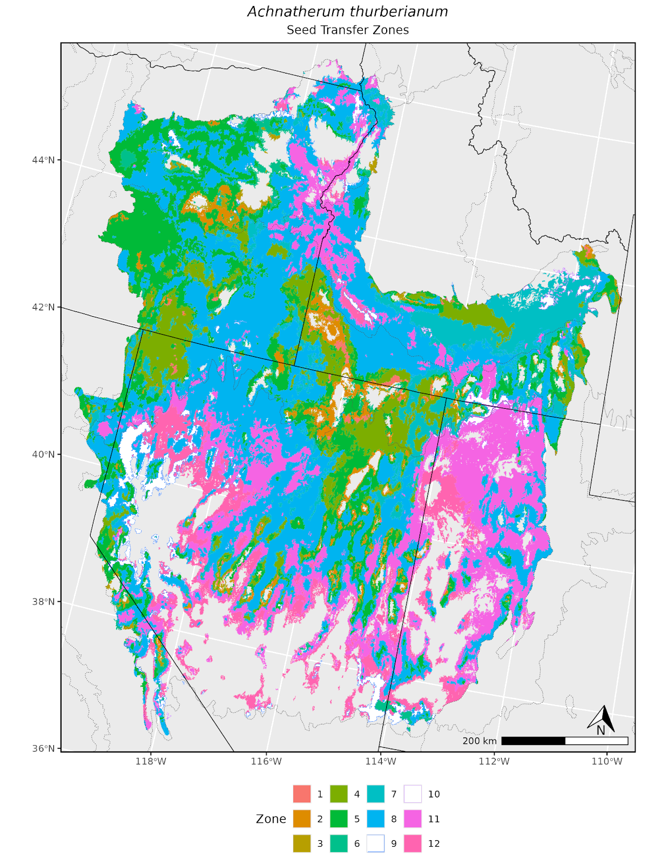

Empirical seed transfer zones require conventions for data sharing to increase their utility
Brianna Wieferich, Reed Benkendorf
E. Woodworth (art) Brianna.Wieferich@usda.gov
Develop 1) file, 2) and field naming standards, 3) cartographic, and 4) directory order conventions to increase consistency between eSTZs
5) Implement suggestions in an R package ‘eSTZwritR’ to aid adherence and allow for rapid uptake of conventions
Incorporate estimates of uncertainty for spatial eSTZ data to support material selection from non-target seed zones
Methods Reviewed all eSTZs on the Western Wildland Environmental Threat Assessment Center (WWETAC) website as of May 1, 2024.
Each data product’s: file name structure, field naming conventions, and directory structure, were analyzed. All scoring was done by hand, and all analyses were carried out in R 4.2.1.
BACKGROUND To increase the availability of locally adapted germplasm, empirical Seed Transfer Zones (eSTZs) are being used to guide restoration and agricultural admixture decisions. eSTZs are based on common garden, genetic, or climate similarity data, and require considerable effort to develop. Despite the rigor with which these studies are conducted, inconsistencies exist in data products derived from them which can hinder their utility and adoption. Here we showcase the inconsistencies in eSTZ data products, offer suggestions for standardization, and report on an R package to implement these suggestions.
Objectives
Suggestions
Directory Structure
We recommend that all directories have two main subdirectories:
- Essential data products (raster and vector data formats)
- Product information (citation, map, metadata attributes)
Results
Field Naming Vector data should follow a predictable pattern, allowing humans interacting with the data to quickly detect their field of interest.
File Naming Convention
We recommend that each file name has three main components:
- The USDA PLANTS code (the specific taxon)
-The type of data used to develop the STZ
-The two main regions which the product overlaps
Estimating Uncertainty
Using multiple predictions to create a consensus product:
- Vector data are generally preferable
- We have observed classification confusion
- We believe the inclusion of raster data is always warranted.
Field Name Consistency
- Different usages of polygon geometry were used to represent the individual seed transfer zones
- Field denoting seed zone was lacking or ambiguous
Map Components
Several essential cartographic (title, statement on data sources, legend for the seed zones) where missing from at least - or nearly half of the products inspected.
Map Formatting
We recommend that each map contains the following elements:
- North arrow
- Scale bar
- State border
- Geographically relevant cities
- Coordinate reference system information
- Color schemes for seed zones
- A legend
- Title (the taxon name)
- Map theme (‘Seed Transfer Zones’) as a subtitle.
R Package
eSTZwritR (‘pronounced easy rider’), can implement all suggestions and lessen the statistical processing, with minimal user inputs.
Field Name Shapefile
- Some consensus with using USDA NRCS-Plants code for taxon denotation
- Many files did not mention their attribute (seed zones)
- Majority of files lack a specified geographic extent
Conclusions Myriad discrepancies exist in the way that eSTZs are being distributed. Here we present standards for the scientists developing eSTZs to use in order to standardize the data products they develop. We provide an R package to implement our suggestions.

